Slide 1
CHAPTER 10:
Computer Peripherals
The Architecture of Computer Hardware, Systems Software & Networking:
An Information Technology Approach
5th Edition, Irv Englander
John Wiley and Sons ©2013
PowerPoint slides authored by Angela Clark, University of South Alabama
PowerPoint slides for the 4th edition were authored by Wilson Wong, Bentley University

Slide 2
Peripherals
Devices that are separate from the basic computer
  Not the CPU, memory, or power source
Classified as input, output, and storage
Connect via
  Ports
  Interface to system bus
Copyright 2013 John Wiley & Sons, Inc.
10-<number>

Slide 3
Storage Devices
Primary memory
Secondary storage
  Data and programs must be copied to primary memory for CPU access
  Permanence of data – nonvolatile
  Online storage
  Offline storage – loaded when needed
  Network file storage
    File servers, web servers, database servers
  Direct access storage devices (DASDs)
Copyright 2013 John Wiley & Sons, Inc.
10-<number>

Slide 4
Speed
Measured by access time and data transfer rate
Access time: average time it takes a computer to locate data and read it
  millisecond (msec) = one thousandth of a second; 0.01 seconds
  microsecond (μsec) = one millionth of a second
  nanosecond (nsec) = one billionth of a second
Data transfer rate: amount of data moved per second
Copyright 2013 John Wiley & Sons, Inc.
10-<number>

Slide 5
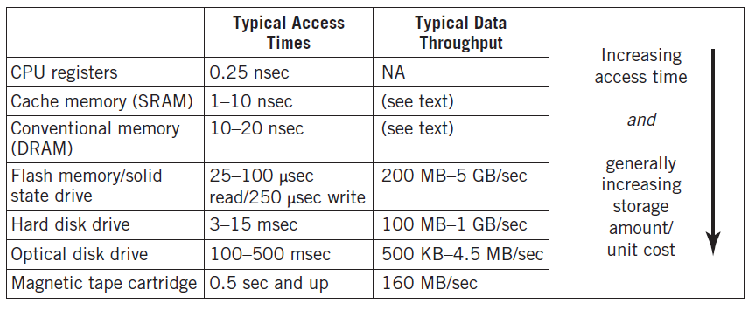
Storage Hierarchy
Copyright 2013 John Wiley & Sons, Inc.
10-<number>

Slide 6
Secondary Storage Devices
Solid state memory
Magnetic disks
Optical disk storage
Magnetic tape
Network storage
Characteristics
  Rotation vs. Linear
  Direct access vs. Sequential access
Copyright 2013 John Wiley & Sons, Inc.
10-<number>

Slide 7
Solid State Memory
Also referred to as flash memory
Nonvolatile electronic integrated circuit memory
Similar to other read-only memory but uses a different technology
Permits reading and writing individual bytes or small blocks of data
Small size makes it useful in portable devices such as tablets, smartphones, USB thumb drives, digital cameras, and music players
Relatively immune to physical shocks
Generates little heat or noise
Copyright 2013 John Wiley & Sons, Inc.
10-<number>

Slide 8
Flash Memory
Solid-state drives
  Large capacity flash memory units
  Starting to replace magnetic disk drives as long-term storage
Data is read/written in blocks
Wear-leveling used to extend life
Controller logic used to manage memory space and provide fast reads/writes
Copyright 2013 John Wiley & Sons, Inc.
10-<number>

Slide 9
Magnetic Disks
Platter made of glass, metal, or plastic with a magnetic coating
Magnetic polarization used to determine 1s and 0s
Track – circle
Cylinder – same track on all platters
Block – small arc of a track
Sector – pie-shaped part of a platter
Head – reads data off the disk as disk rotates at high speed (5400-15,000 RPM)
Copyright 2013 John Wiley & Sons, Inc.
10-<number>

Slide 10
Disk Layouts – CAV vs. CLV
CAV – Constant Angular Velocity
  Number of bits on each track is the same; denser towards the center
  Spins the same speed for every track
CLV – Constant Linear Velocity
  All tracks have the same physical length and number of bits
  Constant speed reading data off a track
  Drive has to speed up when accessing close to the center of the drive and slow down when accessing towards the edge of the drive
Copyright 2013 John Wiley & Sons, Inc.
10-<number>

Slide 11
Disk Layout – Multiple Zone
Multiple zone recording
  Also known as zone bit recording (ZBR) or zone-CAV recording (Z-CAV)
  Compromise between CAV and CLV
  Disk divided into zones
  Cylinders in different zones have a different number of sectors
  Number of sectors in a particular zone is constant
  Data is buffered so the data rate to the I/O interface is constant
Copyright 2013 John Wiley & Sons, Inc.
10-<number>

Slide 12
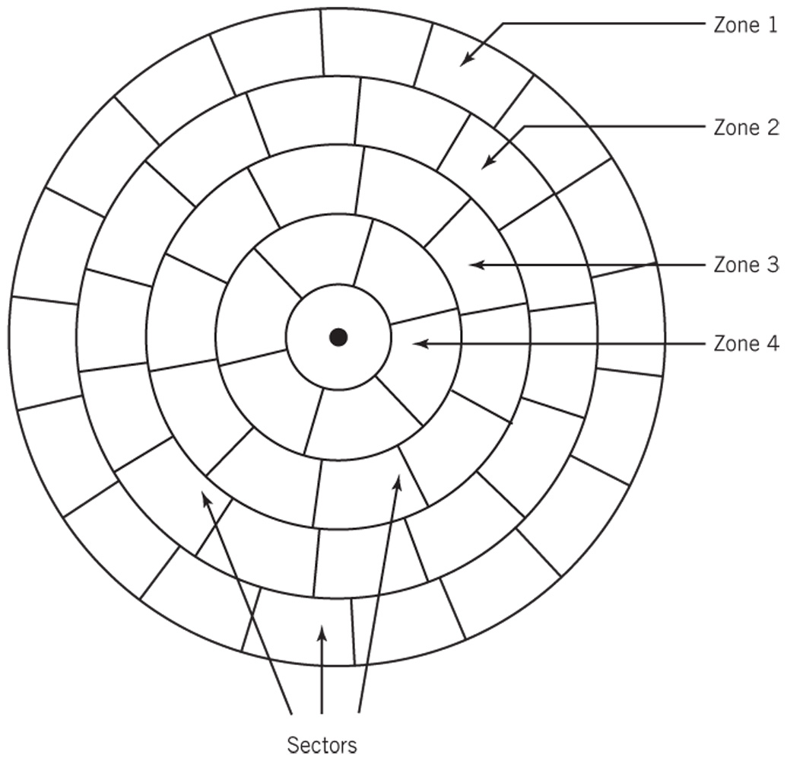
Multiple-Zone Disk Configuration
Copyright 2013 John Wiley & Sons, Inc.
10-<number>

Slide 13
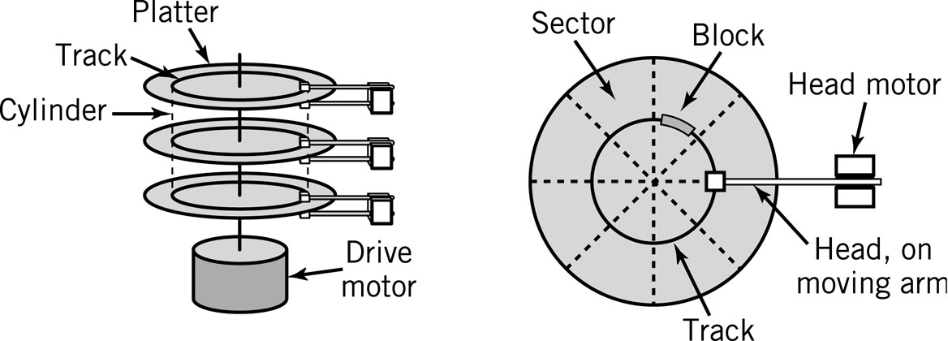
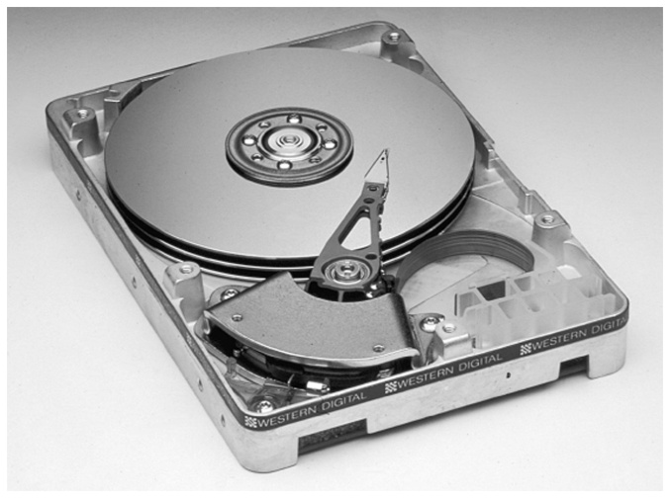
A Hard Disk Layout
Copyright 2013 John Wiley & Sons, Inc.
10-<number>

Slide 14
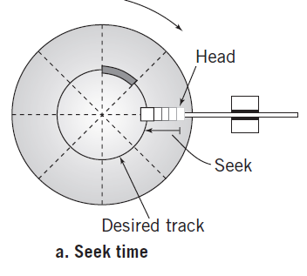
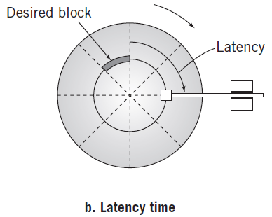
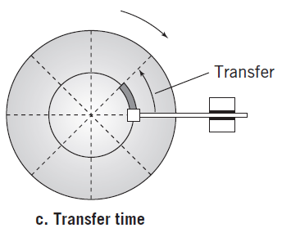
Locating a Block of Data
Seek time: time required to move from one track to another
Latency: time required for disk to rotate to beginning of correct sector
Transfer time: time required to transfer a block of data to the disk controller buffer
Copyright 2013 John Wiley & Sons, Inc.
10-<number>

Slide 15
Disk Access Times
Average Seek time
  Average time to move from one track to another
Average Latency time
  Average time to rotate to the beginning of the sector
  Average Latency time = ½ * 1/rotational speed
Average Transfer time
  1/(# of sectors * rotational speed)
Total time to access a disk block
  Avg. seek time + avg. latency time + avg. transfer time
Copyright 2013 John Wiley & Sons, Inc.
10-<number>

Slide 16
Magnetic Disks
Data Block Format
  Interblock gap
  Header
  Data
Formatting disk
  Establishes the track positions, blocks, and headers needed before use of the disk
Copyright 2013 John Wiley & Sons, Inc.
10-<number>

Slide 17
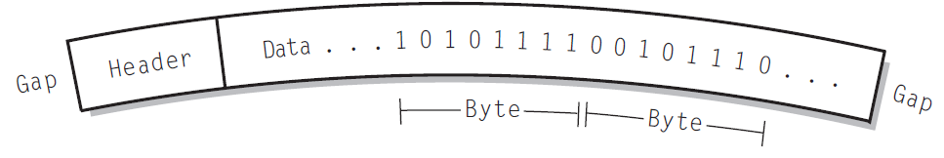
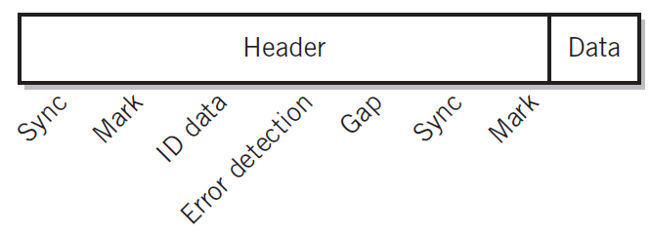
Disk Block Formats
Single Data Block
Header for Windows disk
Copyright 2013 John Wiley & Sons, Inc.
10-<number>

Slide 18
Disk Arrays
Grouping of multiple disks together
RAID – Redundant Array of Inexpensive Disks
  Mirrored array
  Striped array
  RAID 0 to RAID 5
Copyright 2013 John Wiley & Sons, Inc.
10-<number>

Slide 19
RAID – Mirrored
    Two or more disks contain the exact same stores of data
    Reading data – alternate blocks of data are read from hard drives and combined
    Access time is reduced by approximately a factor equal to the number of disk drives in array
    Read failure – block is marked and then read from the mirrored drive
    When using three or more mirrored drives, majority logic is used in the event of a failure. Fault-tolerant computers use this technique.
Copyright 2013 John Wiley & Sons, Inc.
10-<number>

Slide 20
RAID – Striped
A file segment is stored divided into blocks on different disks
Minimum of three drives needed because one disk drive is reserved for error checking
Writes – block of parity words from each block of data is created and put on the reserved error checking disk
Reads – parity data is used to check original data
Copyright 2013 John Wiley & Sons, Inc.
10-<number>

Slide 21
RAID Levels
RAID 0 – not true RAID; no error checking or redundancy, but data is placed across all drives for increased speed
RAID 1 – mirrored array
RAID 2, 3, 4 – arrays that are striped in different ways
RAID 5 – error checking blocks are spread across all drives
Copyright 2013 John Wiley & Sons, Inc.
10-<number>

Slide 22
Optical Storage
Reflected light off a mirrored or pitted surface
CD-ROM
  650 MB of data, approximately 550 MB after formatting and error checking
  Spiral 3 miles long, containing 15 billion bits!
  CLV – all blocks are same physical length
  Block – 2352 bytes
    2k of data (2048 bytes)
    16 bytes for header (12 start, 4 id)
    288 bytes for advanced error control
Copyright 2013 John Wiley & Sons, Inc.
10-<number>

Slide 23
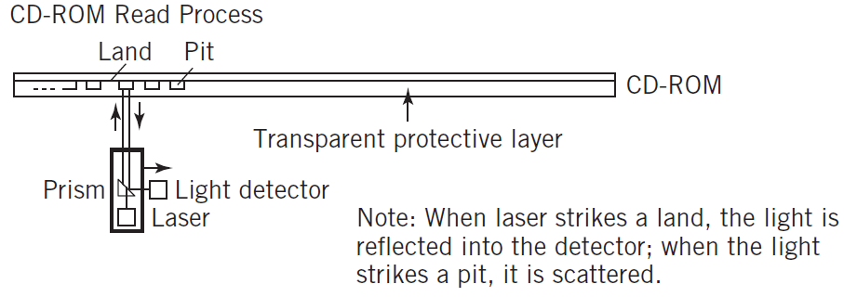
Optical Storage
Laser strikes land: light reflected into detector
Laser strikes a pit: light scattered
Copyright 2013 John Wiley & Sons, Inc.
10-<number>

Slide 24
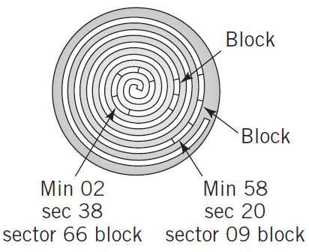
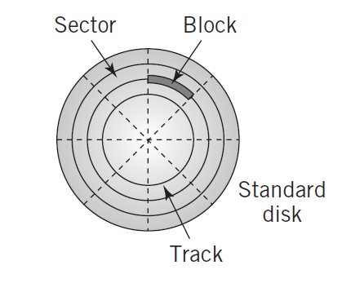
Layout: CD-ROM vs. Standard Disk
CD-ROM
Hard Disk
Copyright 2013 John Wiley & Sons, Inc.
10-<number>

Slide 25
Types of Optical Storage
Medium-powered laser blister technology also used for
  CD-R, DVD-R, DVD-R, DVD+R
  CD-RW, DVD-RW, DVD+RW, DVD-RAM, DVD+RAMBD-RE
File compatibility issues between the different formats
DVD – similar technology to CD-ROM
  Shorter wavelength
  Uses both sides of disc
  Capacity up to 17GB
Blu-Ray DVD – holds more than 50GB
Copyright 2013 John Wiley & Sons, Inc.
10-<number>

Slide 26
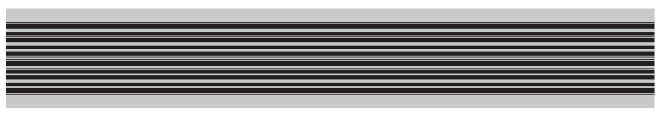
Magnetic Tape
Offline storage
Archival purposes
Disaster recovery
Tape cartridges
  Linear tape open format
  Currently store as much as 3TB of compressed data or 1.5TB of uncompressed data
Copyright 2013 John Wiley & Sons, Inc.
10-<number>

Slide 27
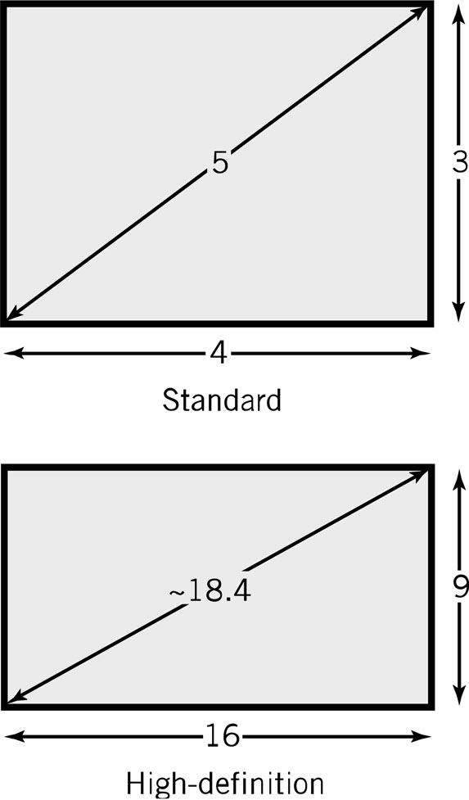
Displays
Pixel – picture element
Screen Size: diagonal length of screen
Aspect ratio – X pixels to Y pixels
  4:3 – older displays
  16:9 – widescreen displays
Pixel color is determined by intensity of three colors – Red, Green and Blue (RGB)
True color – 8 bits for each color
  256 levels of intensity for each color
  256 * 256 * 256 = 16.7 million colors
Copyright 2013 John Wiley & Sons, Inc.
10-<number>

Slide 28
Resolution and Picture Size
Resolution
  Measured as either number of pixels per inch or size of an individual pixel
  Screen resolution examples:
    1024 x 768
    1280 x 720
    1920 x 1080
Picture size calculation
  Resolution * bits required to represent number of colors in picture
  Example: resolution is 100 pixels by 50 pixels, 4 bits required for a 16 color image
  100 * 50 * 4 bits = 20,000 bits
Video memory requirements are significant!
Copyright 2013 John Wiley & Sons, Inc.
10-<number>

Slide 29
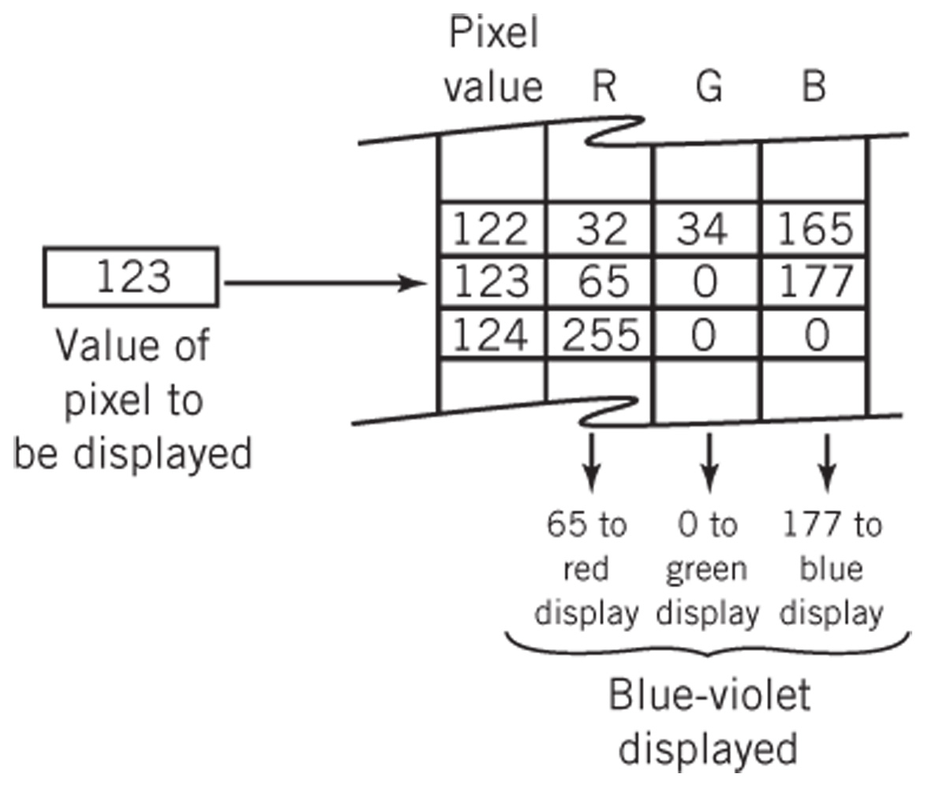
Color Transformation Table
Copyright 2013 John Wiley & Sons, Inc.
10-<number>

Slide 30
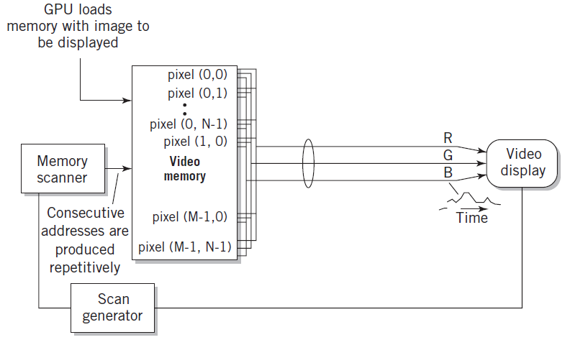
Diagram of Raster Screen Generation Process
Copyright 2013 John Wiley & Sons, Inc.
10-<number>

Slide 31
Graphical Processing Units
Modern graphics requirements need dedicated processing units
Application processing interfaces supply common graphics processing operations
Standards
  OpenGL
  DirectX
Copyright 2013 John Wiley & Sons, Inc.
10-<number>

Slide 32
Graphical Processing Units
May be integrated, standalone units, or separate chips
Maximize number of operations by use of parallelization
Integrated multiple multicore processors
Streaming dispatches instructions to CPU cores in rapid succession
Copyright 2013 John Wiley & Sons, Inc.
10-<number>

Slide 33
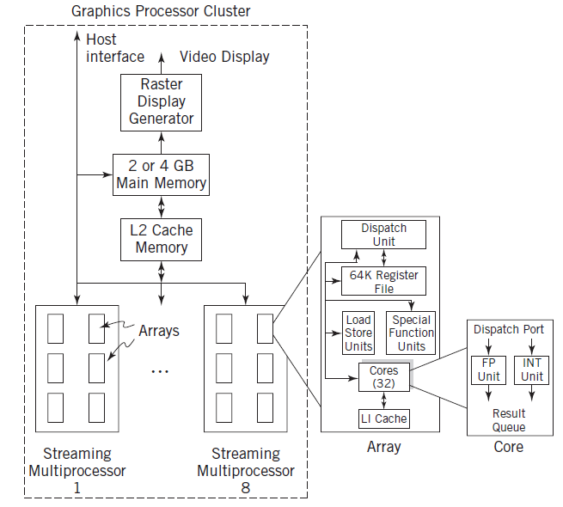
Typical GPU Block Diagram
Copyright 2013 John Wiley & Sons, Inc.
10-<number>

Slide 34
LCD – Liquid Crystal Display
Fluorescent light or LED panel
Three color cells per pixel
Operation
  First filter polarizes light in a specific direction
  Electric charge rotates molecules in liquid crystal cells proportional to the strength of colors
  Color filters only let through red, green, and blue light
  Final filter lets through the brightness of light proportional to the polarization twist
Copyright 2013 John Wiley & Sons, Inc.
10-<number>

Slide 35
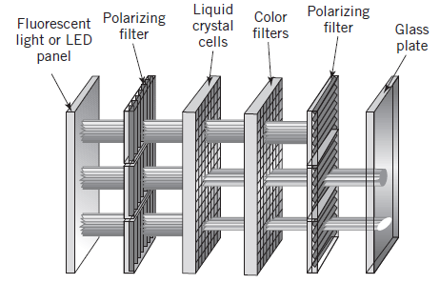
Liquid Crystal Display
Copyright 2013 John Wiley & Sons, Inc.
10-<number>

Slide 36
LCDs (continued)
Active matrix
  One transistor per cell
  More expensive
  Brighter picture
Passive matrix
  One transistor per row or column
  Each cell is lit in succession
  Display is dimmer since pixels are lit less frequently
Copyright 2013 John Wiley & Sons, Inc.
10-<number>

Slide 37
OLED Display Technology
No backlight
Consists of red, green, and blue LEDs
Each LED lights up individually
Used in mobile phones and tablets
Copyright 2013 John Wiley & Sons, Inc.
10-<number>

Slide 38
Printers
Dots vs. pixels
  600 - 2400 dpi vs. 100 - 250 pixels per inch
  Dots are on or off; pixels have intensities
Types
  Typewriter / Daisy wheels – obsolete
  Impact printing – dot matrix – mostly obsolete
  Inkjet – squirts heated droplets of ink
  Laser printer
Copyright 2013 John Wiley & Sons, Inc.
10-<number>

Slide 39
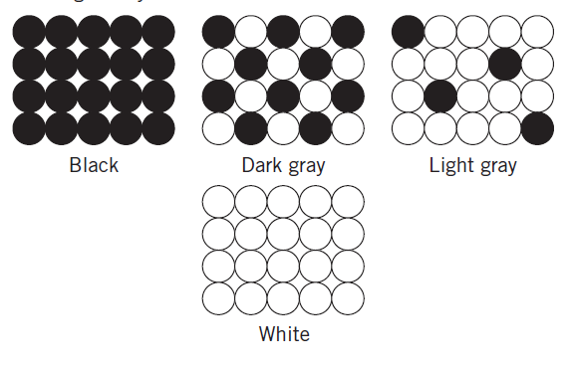
Creating a Gray Scale
Copyright 2013 John Wiley & Sons, Inc.
10-<number>

Slide 40
Laser Printer Operation
Dots of laser light are beamed onto a drum
Drum becomes electrically charged
Drum passes through toner which then sticks to the electrically charged places
Electrically charged paper is fed toward the drum
Toner is transferred from the drum to the paper
The fusing system heats and melts the toner onto the paper
A corona wire resets the electrical charge on the drum
Copyright 2013 John Wiley & Sons, Inc.
10-<number>

Slide 41
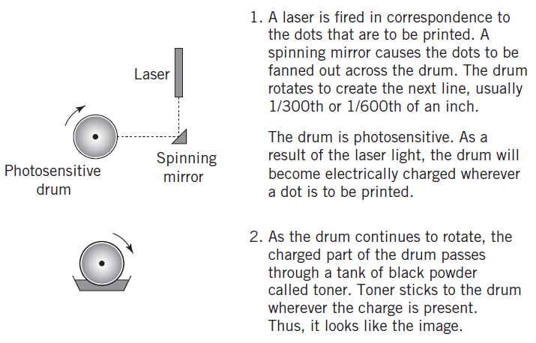
Laser Printer Operation
Copyright 2013 John Wiley & Sons, Inc.
10-<number>

Slide 42
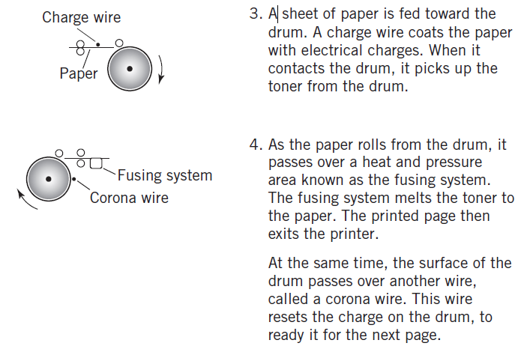
Laser Printer Operation
Copyright 2013 John Wiley & Sons, Inc.
10-<number>

Slide 43
Inkjet Printers
Advantages: small size and economy
High-quality ink capable of photographic quality color output
Print cartridge moves across page to print rows of dots
Copyright 2013 John Wiley & Sons, Inc.
10-<number>

Slide 44
User Input Devices
Keyboard, mouse, touch screens, graphics tablets, game controllers
Bar code and QR code readers
Magnetic Stripe Readers
RFID Input and Smart Cards
Voice Input
Optical Character Recognition
Copyright 2013 John Wiley & Sons, Inc.
10-<number>

Slide 45
Other Computer Peripherals
Scanners
  Flatbed, sheet-fed, hand-held
  Light is reflected off the sheet of paper
Multimedia Input
  Digital Cameras, Audio Input
Mobile Devices
  Smartphones, tablets
  Global Positioning Systems (GPS)
  Linear accelerometers
Copyright 2013 John Wiley & Sons, Inc.
10-<number>

Slide 46
Network Communication Devices
Network is just another I/O device
Network I/O controller is the network interface card (NIC)
Medium access control (MAC) protocols
  Define the specific rules of communication for the network
Copyright 2013 John Wiley & Sons, Inc.
10-<number>

Slide 47
Copyright 2013 John Wiley & Sons
All rights reserved. Reproduction or translation of this work beyond that permitted in section 117 of the 1976 United States Copyright Act without express permission of the copyright owner is unlawful. Request for further information should be addressed to the Permissions Department, John Wiley & Sons, Inc. The purchaser may make back-up copies for his/her own use only and not for distribution or resale. The Publisher assumes no responsibility for errors, omissions, or damages caused by the use of these programs or from the use of the information contained herein.
Copyright 2013 John Wiley & Sons, Inc.
10-<number>

